Slide 1
Breast Cancer Detection using
Machine Learning
Katarzyna Banasik, 28.10.2026

Slide 2
Project Overview
This project aims to automate the detection of breast cancer using clinical feature data, focusing on high-
recall performance (>85%) to minimize false negatives in malignant cases.
Objective: Build a robust diagnostic classifier.
Dataset: Breast Cancer Wisconsin (sklearn).
Key Metric: Recall for Malignant class (Sensitivity).

Slide 3
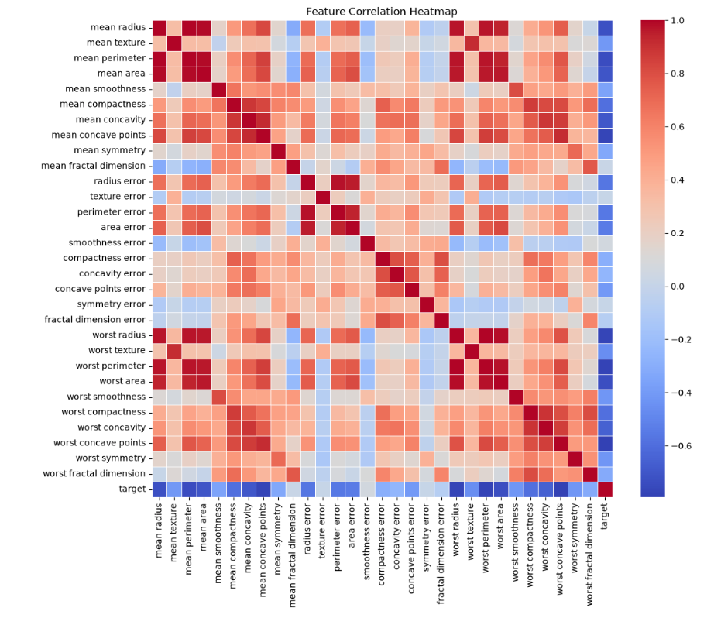
Data Preparation & EDA
The dataset includes 30 numerical features derived from digitized images of fine needle aspirates (FNA).
Normalization of the features.
Correlation analysis to identify key predictors. PCA component analysis.

Slide 4
Feature Engineering
Selection of features that provide the most significant separation between classes, dropping ones that have <0.01 importance after normalization.
Feature | Importance
Mean Concave Points | High
Worst Radius | High
Worst Area | Medium-High

Slide 5

Model Selection & Methodology
Evaluation of multiple algorithms to find the optimal balance of accuracy and clinical safety.
Random Forest Classifier.
Logistic Regression (Baseline).
Support Vector Machines (SVM).
Gradient Boosting.
K-nearest neighbours.
I chose the Random Forest classifier because of the highest recall from all.

Slide 6
Training Process
Optimizing hyperparameters for the Random Forest model.
RandomSearchCV fine-tuning

Slide 7
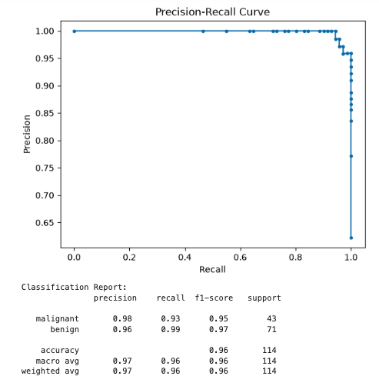
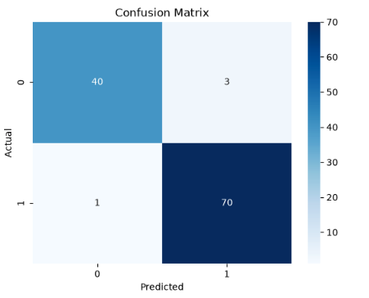
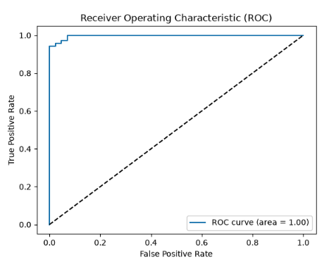
Results: Performance Metrics
Final model performance on the hold-out test set.
Accuracy: ~96%
Precision: High.
Recall (Malignant): Target reached (>85%) as the recall is around 97%.

Slide 8
Results: Performance Metrics

Slide 9
API Development
Converting the model into a usable service via FastAPI.
/predict
Input: JSON feature array.
Output: Classification result with probability scores.
Details in the README.md file

Slide 10
System Architecture
Model: Scikit-learn / Joblib.
Web Framework: FastAPI (Python).
Infrastructure: Dockerized Container.
Deployment: Cloud-ready (GCP / Heroku).

Slide 11
Thank You!
Questions? Feel free to reach out via GitHub.
Katarzyna Banasik, 28.10.2026

